Slide 1
Open GL (Open Graphics Library)
Ahmed Mahmoud Sultan

Slide 2








Phone
Instructor
Questions
Rules
Bonus
Attendance
Assignment
Eat & Drink
expulsion

Slide 3
Agenda
What is OpenGL?!
Advantages Vs Disadvantages of OpenGL?!
Environment initialization.
Content Of OpenGL that we will study.
OpenGl Primitives.

Slide 4

What is OpenGL?!
OpenGL (Open Graphics Library) is the computer industry's standard application program interface ( API ) for defining 2-D and 3-D graphic images. Prior to OpenGL, any company developing a graphical application typically had to rewrite the graphics part of it for each operating system platform and had to be cognizant of the graphics hardware as well. With OpenGL, an application can create the same effects in any operating system using any OpenGL-adhering graphics adapter.

Slide 5
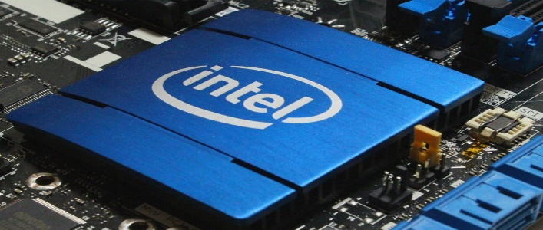
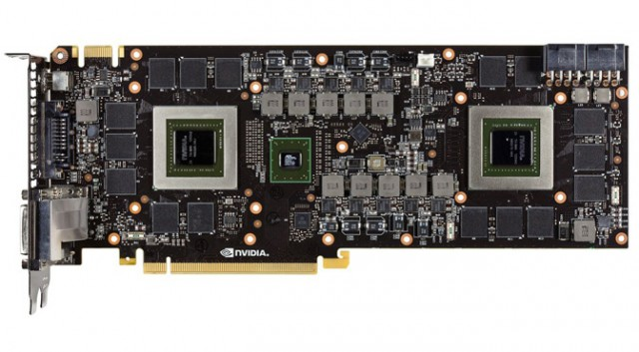
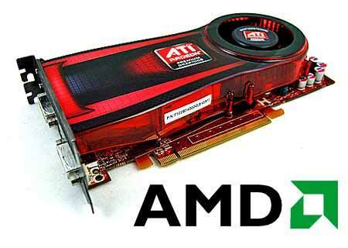
What is OpenGl?! cont…
Who Actually write the code that get called when you call an openGL function??!
Your pc or laptop manufacture.
Intel
Nvidia
AMD

Slide 6
Advantages Vs Disadvantages of OpenGL?!
Advantages :
Easy to learn.
Cross Platform(Windows – Linux - Mac).
Easy to understand (Teamwork).
Disadvantages :
It is very complicated and takes a long time to learn it.
Tends to run slightly slower than say DirectX.

Slide 7
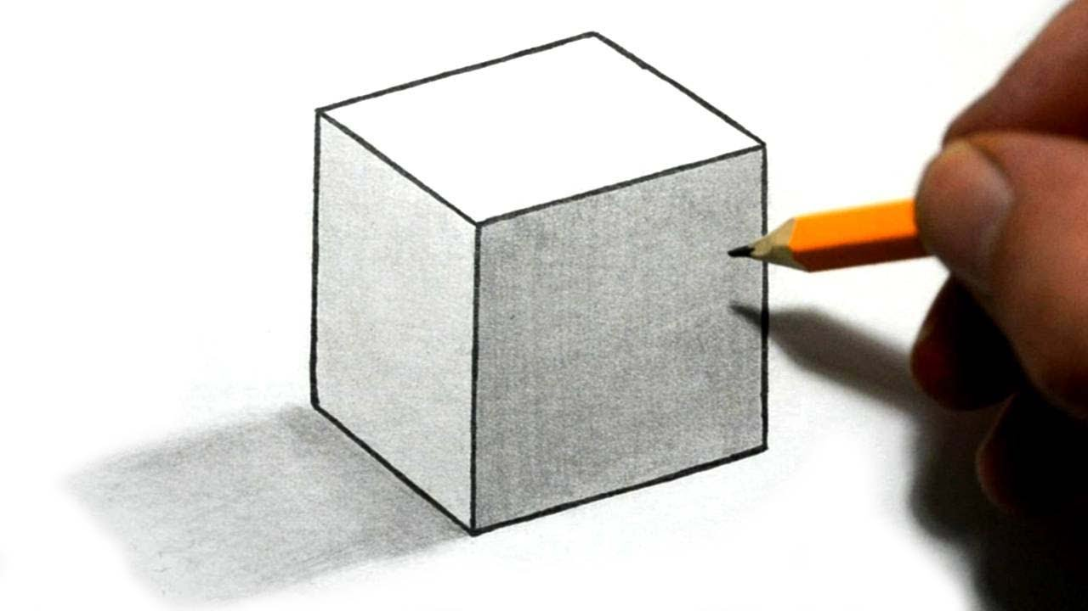
3D miss understanding!

Slide 8
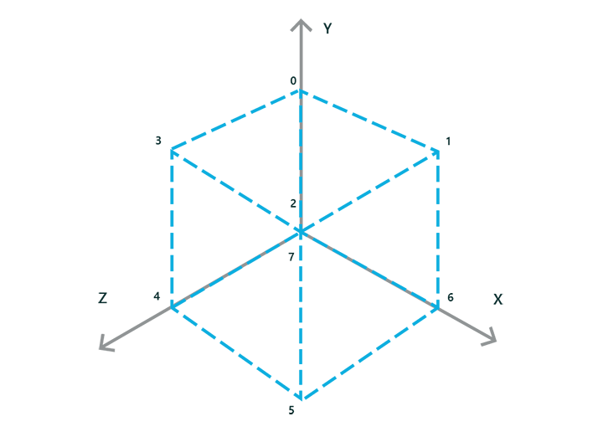
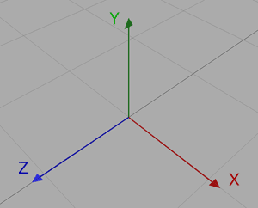
3D miss understanding! Cont…

Slide 9
Content Of OpenGL that we will study
Simple Drawings.
Transformations.
Textures
Lighting materials.
Effects.
Camera and controls.
Bezier curves.
3D objects.

Slide 10
OpenGl File Structure
Headers
GL.h
GLU.h
GLUT.h
GLAUX.h
Libraries
freeGlut.lib
Glaux.lib
GLU32.lib.
GLUT/lib
DLL
OpernGL32.dll.
GLU32.dll.
GLUT.dll.
Notes:
GL(Graphics Library): for drawing primitive or basics drawing such as (rectangle, Squares and lines)
GLU(Graphics Libraries Utilities ) : For advanced drawings such as 3D.
GLUT(Graphics Libraries Utilities Toolkit) : responsible for receiving user’s input data through input devices (joysticks,keyboard,mouse,…) in addition to that it provides more windows opened at the same time and provide also more 3d animations.
GLUI(Graphics Libraries Utilities Interface): for creating components on screen for insertion such as textbox.

Slide 11
How to Install OPenGL Libraries
You will need to create the “gl” folder in
“C:\Program Files (x86)\\Microsoft Visual Studio 10.0\VC\include\”, as it doesn’t already exist. and extract GL Files.
Put all files already exists in dll folder into Location
C:\Windows\SysWOW64\
C:\Windows\System32\
Put all files already exists in GL folder into Location C:\Program Files (x86)\Microsoft Visual Studio 10.0\VC\include\gl\
Put all files already exists in GL folder into Location C:\Program Files (x86)\Microsoft Visual Studio 10.0\VC\Lib\
Launch Visual Studio and Creating Project Visual C++\Win32\Win32 Console Application
(Linking Library) Right-click the project you created, go to Properties, then open Configuration Properties\Linker\Input and add the following to the “Additional Dependencies” field: “opengl32.lib;glut32.lib;glu32.lib”. Close the settings.
Modify your main .cpp file .

Slide 12
glutInitWindowPosition & glutInitWindowSize
glutInitWindowPosition and glutInitWindowSize set the initial window position and size respectively.
Usage : void glutInitWindowSize(int width, int height);
void glutInitWindowPosition(int x, int y);

Slide 13
glutCreateWindow
glutCreateWindow create new window with the previous window size and window position.
Usage: glutCreateWindow("name");
- The name will be provided to the window system as the window's name.

Slide 14
glClearColor
glClearColor specify clear values for the color buffers
Usage: glClearColor(red, green, blue, alpha);
- The alpha is opacity.
- Values specified by glClearColor from 0 to 1.

Slide 15
glClear
glClear clear buffers before starting drawing.
Usage: glClear(GL_COLOR_BUFFER_BIT);
GL_COLOR_BUFFER_BIT: Indicates the buffers currently enabled for color writing.

Slide 16


GL_COLOR_BUFFER_BIT && GL_DEPTH_BUFFER_BIT
GL_COLOR_BUFFER_BIT and GL_DEPTH_BUFFER_BIT aren't functions, they're
constants. You use them to tell glClear() which buffers you want it to clear
void render()
{
glClear(GL_COLOR_BUFFER_BIT);
glFlush();
}
Function to be used in main
glutInitDisplayMode(GLUT_SINGLE | GLUT_RGB);
void render()
{
glClear(GL_COLOR_BUFFER_BIT | GL_DEPTH_BUFFER_BIT);
glutSwapBuffers();
}
Function to be used in main
glutInitDisplayMode(GLUT_DOUBLE | GLUT_RGB);
glutInitDisplayMode(GLUT_DOUBLE | GLUT_RGBA | GLUT_DEPTH);

Slide 17
Clearing Buffers
To clear the color buffer (using RGBA):
glClearColor (0.0, 0.0, 0.0, 0.0); glClear (GL_COLOR_BUFFER_BIT);
To clear color and depth buffers:
glClearColor (0.0, 0.0, 0.0, 0.0); glClearDepth (1.0);
glClear (GL_COLOR_BUFFER_BIT |GL_DEPTH_BUFFER_BIT);

Slide 18
Specifying a Color
Specifying RGB values as floats between 0.0 and 1.0, this will specify red:
glColor3f (1.0, 0.0, 0.0);

Slide 19
Forcing completion of Drawing
Use this call at the end of each frame:
glFlush();
This call will wait for the drawing to finish:
glFinish();

Slide 20
GlBegin()
Tells OpenGl that is ready to start drawing.
Then it asks what shape do you need to draw?!
Function prototype:
glBegin (Mode);

Slide 21
glBegin()
MODE | Value
Point | GL_POINTS
Line | GL_LINES, GLINE_STRIP, GL_LINE_LOOP
triangles | GL_TRIANGLES,GL_TRIANGLE_STRIP,GL_TRIANGLE_FAN
Quad | GL_QUADS, GL_QUAD_STRIP
Polygon | GL_POLYGON

Slide 22
glEnd()
It Tells the OpenGl that it had finished drawing the specified primitive defined by glBegin().
To draw another shape we need to define another glBrginfunction and glEnd function().
Method:
glEnd();

Slide 23
GL_Points Mode
It draws a specified point on your window using glvertx2d function
Ex : glBegin(GL_POINTS);
glVertex2f(-0.5, -0.5);
glVertex2f(0.5, -0.5);
glVertex2f(0.5, 0.5);
glVertex2f(-0.5, 0.5);

Slide 24
GL_Line
It draws a line from two points
Ex: glVertex3d(0.1, 0.0,0.0);
glVertex3d(0.1, 0.9, 6.0);

Slide 25
Special functions
glPointSize(Size); it specifies the size of each point on screen.
glColor3ub(red,gree,blue);
glLineWidth(width); it specifies the width of line.

Slide 26
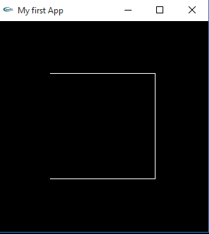
GL_Line_STRIP
It draws a connect set of lines starting from the first point to the end of the final point.
Ex : glBegin(GL_LINE_STRIP);
glVertex2d(-0.5, -0.5);
glVertex2d(0.5, -0.5);
glVertex2d(0.5, 0.5);
glVertex2d(-0.5, 0.5);

Slide 27
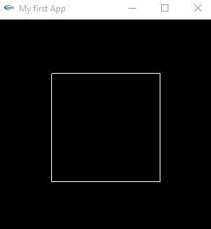
GL_LINE_LOOP
It draws a connected set of lines where the first point and final point are matched.
Ex: glBegin(GL_LINE_LOOP);
glVertex2d(-0.5, -0.5);
glVertex2d(0.5, -0.5);
glVertex2d(0.5, 0.5);
glVertex2d(-0.5, 0.5);

Slide 28
GL_TRIANGLES
Draws triangles on screen. Every three vertices specified
compose a triangle.

Slide 29
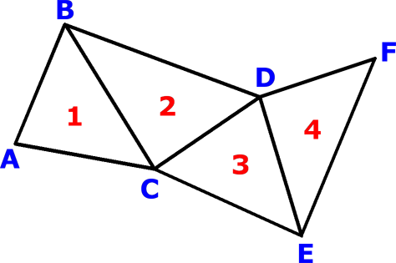
GL_TRIANGLE_STRIP
Draws connected triangles on screen. Every vertex specified after first three vertices creates a triangle.

Slide 30
GL_TRIANGLE_FAN
Draws connected triangles like GL_TRIANGLE_STRIP, except draws triangles in fan shape.
Notes:
When knowing the difference between Triangle Strip and Triangle Fan a shape will be easy to make.
Triangle Strip
For instance a Triangle Strip is a set of connected triangles which share vertices.
Example of Triangle Strip
Using Triangle Strip we will be able to get the following output, using those given vertices.
Triangle Fan
Where a Triangle Fan is also a set of connected triangles, though all these triangles have a common vertex, which is the central vertex.
In OpenGL the central vertex is the first given vertex, in the Triangle Fan.
Example of Triangle Fan
Using Triangle Fan and the same vertices as in the other example, we will only be able to get the colored area as output. That is due to the importance of the arranged order of the vertices in Triangle Fan. Basically, all the vertices need to go around the central vertex.
Conclusion
As you can see on our 2 example sets of vertices those "output shapes" are unique to both Triangle Strip and Triangle Fan.

Slide 31
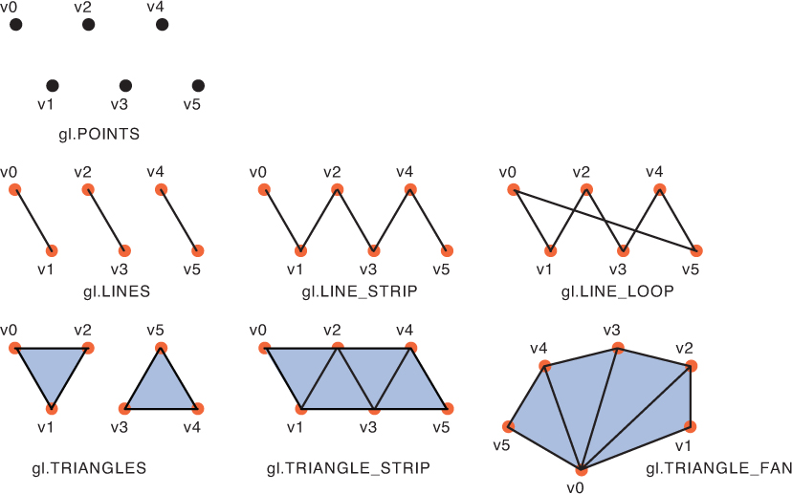

Slide 32
GL_QUADS
Draws quadrilaterals (4 – sided shapes) on screen. Every four vertices specified compose a quadrilateral.

Slide 33
GL_QUAD_STRIP
Draws connected quadrilaterals on screen. Every two vertices specified after first four compose a connected quadrilateral.

Slide 34
GL_POLYGON
Draws a polygon on screen. Polygon can be composed of as many sides as you want.

Slide 35

Sheet 4
Draw this shape using OpenGl Primitive functions

Slide 36
The End

